Slide 1
Smart Start Lead Generation Program Western Region
August, 2010

Slide 2
Integrated Programs to Drive Fixed Printer Demand
Smart Start* Programs
Lead Generation Program
- Dedicated, IN-funded lead generation program for select partners in the Northwest region
Focus on high-potential value proposition: Smart Printing
- Primary Telemarketing
- July 26th – Oct 31st
Printer Trade-in Program
End-user facing program, partners can leverage
Offer: Up to $450 rebates
Feb 1 to December 31st
Smart Printing Messaging Campaign
End User facing program, partners can also leverage
Offers: Smart Printing WP, calculator, case studies, etc.
Will kick off in Q3, run through 2010
*Smart Start is the overall program name for the marketing initiatives that will drive Fixed Printer & Media revenue opportunities in the channel in 2010 . It is not the name of the individual campaign components or assets.

Slide 3
Integrated Programs to Drive Fixed Printer Demand
Smart Start* Programs
Lead Generation Program
- Dedicated, IN-funded lead generation program for select partners in the Northwest region
Focus on high-potential value proposition: Smart Printing
- Primary Telemarketing
- July 26th – Oct 31st
Printer Trade-in Program
End-user facing program, partners can leverage
Offer: Up to $450 rebates
Feb 1 to December 31st
Smart Printing Messaging Campaign
End User facing program, partners can also leverage
Offers: Smart Printing WP, calculator, case studies, etc.
Will kick off in Q3, run through 2010
*Smart Start is the overall program name for the marketing initiatives that will drive Fixed Printer & Media revenue opportunities in the channel in 2010 . It is not the name of the individual campaign components or assets.

Slide 4
Smart Start Lead Generation Program – Participating Partners
Northwest Region
Barcodes West
GSD and Associates
Legend ID
Pacific ID
SK & T
California
ADC
MSA Systems
Redline
Royce Digital

Slide 5
Smart Start Lead Gen – Intermec delivers…
Intermec-funded, focused lead generation program for select, high potential partners
Integrated telemarketing & email program managed by IPC
Regional, industry-specific new-prospect lists
Dedicated telemarketing resources
Experienced, Smart-Printing trained telemarketers
Expanded team from 2009/2010 Pilot Program
Extensive Smart Printing Resources
Sales tools, co-brandable materials, training
Sweetener Offers for Customers, Partners
Printer Trade-in Rebates – End Users

Slide 6
Smart Start Lead Gen – Partners deliver…
Follow-up on leads in timely manner
Contact customers as quickly as possible
Update Salesforce.com (lead management system) regularly
Coordinate with your Regional Printer Sales Contact
Communicate & team on sales opportunities to maximize success
Get trained on Smart Printing training
Leverage resources available from your Printer Sales Contact, the IPC Smart Start site, Intermec INsider and Intermec University
Take advantage of Marketing Opportunities
Co-brandable materials on the Partner Marketing Centre (www.intermec.com/pmc)
All Smart Printing materials on IPC Smart Start Program site http://PartnerConcierge.com/smartstart.php

Slide 7
Program Overview
Goal
Leverage unique Smart Printing differentiator to generate fixed printer sales opportunities for select Intermec Partners
Target Audience
Regionally-specific, Smart Printing-relevant industries/ applications/ titles (see next slide)
Offers
Find out how Smart Printers can streamline and improve your printing operations
Earn up to $450 in rebates through the Printer Trade-in Program
Tactics
Telemarketing (and emails) to regionally specific lists
Process
Leads distributed to regional Printer Sales Contact, who re-assigns to participating partners via Salesforce.com lead management system
Partners follow up with customers, update lead records in Salesforce.com

Slide 8
Program Overview continued
Target Audience
Titles: Operations/ Warehouse Management, Quality/ Compliance Management, IT Management
Applications/ Industries: Manufacturing, Warehousing, Food & Beverage, Healthcare
Geography: Western Region
Timeline
Telemarketing: July 26th – Oct 31st
Email Blasts: August, Sept., Oct.
Program Review: Weekly
Lead Delivery: Daily, ongoing
Lead Status Review: Weekly

Slide 9
Telemarketing Approach
Target Quality and Warehouse contacts first
Position IN Smart Printing Differentiators
Extremely quick ROI and low TCO
Simplified printing infrastructure
Remote printer management capabilities
Ability to integrate with and control other devices
Probe for application/ industry-specific pains
Leverage complete set of Smart Printing Resources as well as Trade-in offer to develop qualified lead

Slide 10
Lead Definition
Captured in Lead Detail in Salesforce.com
Qualified leads captured will be defined by one of three categories:
A Lead -
Established Budget, Authority, Needs and Timeline with interest to meet or receive a call from a sales associate.
B Lead -
May have a project in the near future, is interested in more information and would like a sales associate to contact them.
C Lead -
Company is interested in products/solutions/demo and would like a sales associate to contact them in xx days.

Slide 11
Leads
Update your Leads in Salesforce.com : www.salesforce.com
If you have questions or need training on how to use the Salesforce.com lead management system, contact:
Dave Koering – Senior Manager, Global Lead Management
Dave.koering@intermec.com – (319) 369-3705
Lead Status Tracking and Reporting
Walter Mikaelian – Intermec Partner Concierge
walter@partnerconcierge.com - (480) 350-7999

Slide 12
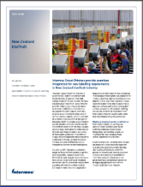
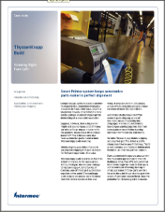
Smart Start Program Resources - SALES
http://PartnerConcierge.com/smartstart.php
Smart Start Lead Gen Resource Site
Please use your IPC User ID or register as a new user to access the site
Program Reference Information, Sales Tools and Customer-facing Materials (case studies, white papers, trade-in coupons, product profiles)
+ NEW: Smart Printing Partner Video

Slide 13
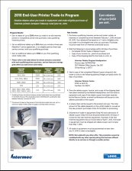
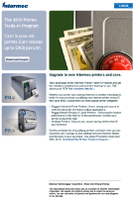
Smart Start Program Resources – MARKETING
www.intermec.com/pmc
Intermec Partner Marketing Center
Please use your Salesforce.com User ID or register as a new user to access the site
Co-brandable Customer-facing Materials (white papers, trade-in coupons/email signatures/templates, product profiles)

Slide 14
Questions?
Program Management
Walter Mikaelian – Intermec Partner Concierge
(480) 350-7999
Walter@PartnerConcierge.com
Intermec
Greg O’Brien – Intermec Global Channel Manager
Mark Quinn – Northwest, Intermec Sales Team
Roger McCloskey – California, Intermec Sales Team

Slide 15
Appendix

Slide 16
Smart Printing End User Value Proposition
Advantage | Benefit
Eliminate need for PCs | Lower TCO; smaller initial investment; smaller ongoing costs; simpler infrastructure; more reliable solution; smaller space requirements
Low cost compared to traditional solutions | Extremely fast ROI; easier to get funding to implement
“Error-proof” labeling | Eliminates rework and risk of mistake penalties
Move label printing task to point of application | fewer wasted labels; higher productivity
Simple, intuitive applications running on printer | Reduced support costs; simpler & less expensive to train users
Simpler overall solution | Simpler solutions are more robust

Slide 17
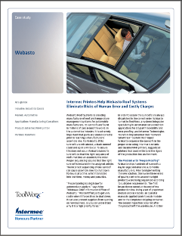
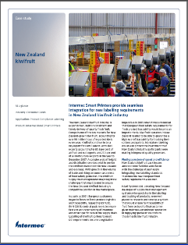
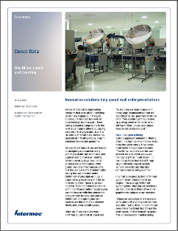
Smart Printing Resources
Warehouse / Manufacturing
Automotive – parts labeling ^{CS}
Automotive – container shipping ^{CS}
Manufacturing – product labels ^{CS}
Aluminum smelting – ingot labeling/tracking
Manufacturing automation – PLC replacement
Transportation & Logistics
Parcel delivery – parcel tracking ^{CS}
Parcel delivery – package re-labeling
Water delivery – dispenser tracking
Mail delivery – sort-system tracking
Shipping room – shipment verification
Retail
Convenience stores – sandwich labeling
Consumer Goods
Agribusiness – food product packaging ^{CS}
Grocery – distribution center 100% uptime
Healthcare
Device manufacturing – component labeling ^{CS}
Pharmacy – IV infusion pump Rx assurance
Prescriptions – online prescription fulfillment ^{CS}
Hospitals – microbiology lab labels
^{CS} - Case study available on IPC Smart Start site
Notes:
Intermec provides many resources to help sell Smart Printing solutions. We have a number of case studies in different market segments – just look for them on our web site.
We are also developing a playbook of application briefs providing quick-glance solution ideas.

Slide 18
Program Resources Available on IPC Portal
 | Application | Industry | Highlights
White Paper A Guide to Smart Printing | All | Multiple | Overview
Case Studies
NZ Kiwifruit | Packaging (Manufacturing) | Food | Compliance Labeling, Worker Productivity, Simplicity, Reliability, Speed
Medtronic | Manufacturing | Healthcare | Accuracy, Worker Productivity, Reduced IT complexity
Webasto | Manufacturing | Automotive | Accuracy/ Error-Proofing, Cost Savings, Serialized Labeling
ThyssenKruppBudd | Manufacturing | Automotive | Accuracy/ Error-proofing, Serialized labeling
Denco Data | Packaging (Prescription Labeling) | Healthcare | Accuracy, Worker Productivity, Cost Reduction
Longaberger | Packaging (Product Labeling) | Consumer Goods | Worker Productivity, Cost Reduction
Brochure Industrial Printer Selection Guide | Industrial | Multiple | Brief overview all printers, selection criteria
Product Profiles PM4i PX4i Etc. | Mid-Range Hi Performance | Multiple | Product overview, photo, specifications
Printer Trade-In Coupon | All | Multiple | Qualifying Purchases, Rebate Levels

